Slide 1






TISB HACKATON ‘24
Diagnosing Pneumonia
By Keyush and Shiva

Slide 2

795,000 Americans are affected by medical misdiagnoses annually and nearly half die !
Source: https://www.businessinsider.in/science/news/new-study-says-800000-americans-die-or-are-disabled-by-misdiagnoses-each-year-but-there-are-3-simple-questions-to-ask-to-lower-your-risk/articleshow/101996116.cms
Photo by Luan Rezende: https://www.pexels.com/photo/wavelength-1093161/

Slide 3
The Top 5 most misdiagnosed diseases account for 38.7% of all misdiagnosed cases
Stroke, Sepsis, Pneumonia, Venous Thromboembolism, and Lung Cancer.
Reducing diagnostic errors by 50% for stroke, sepsis, pneumonia, pulmonary embolism and lung cancer could cut permanent disabilities and deaths by 150,000 per year.
Source: (1) https://www.usatoday.com/story/news/health/2023/07/18/medical-misdiagnosis-killing-disabling-americans/70423573007/ (2) https://qualitysafety.bmj.com/content/early/2023/07/16/bmjqs-2021-014130
Photo by Luan Rezende: https://www.pexels.com/photo/wavelength-1093161/

Slide 4
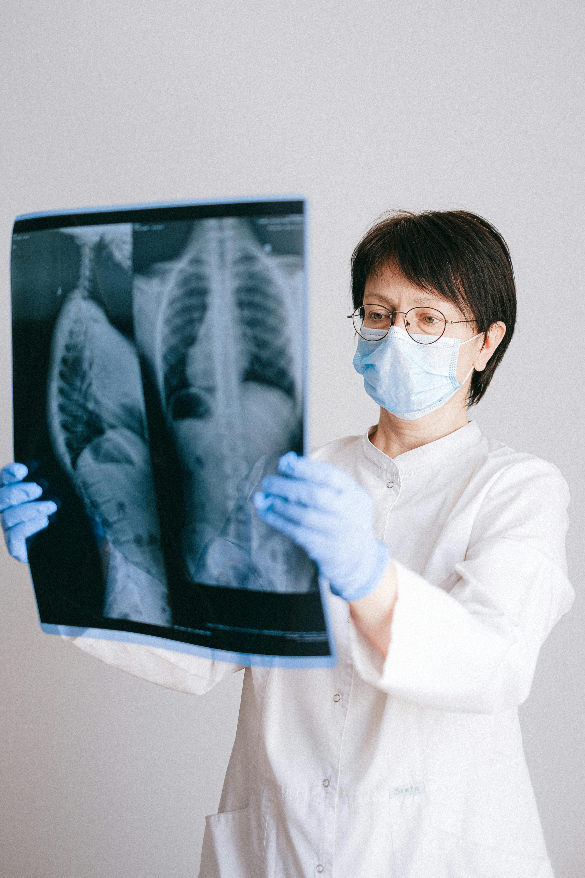
The chest X-ray (CXR) is an important diagnostic tool in diagnosing and monitoring a spectrum of diseases including Pneumonia
But it is considered to be the most difficult to interpret
Approx 1 billion radiologic imaging examinations are performed annually worldwide.
The incidence of errors may be as high as 30%
The most common misdiagnosis for Pneumonia was upper respiratory tract infection
35% of doctors were unable to differentiate between heart failure and pneumonia
Source: (1) https://www.ncbi.nlm.nih.gov/pmc/articles/PMC4954299/#:~:text=Doctors%20were%20on%20average%20over,TB%20and%20pneumonia%20were%20lower (2) https://www.sciencedirect.com/science/article/pii/S0012369222040818
(3) https://www.rcpjournals.org/content/clinmedicine/13/4/349 (4) https://pubmed.ncbi.nlm.nih.gov/32723999/
Photo by Anna Shvets: https://www.pexels.com/photo/photo-of-doctor-holding-x-ray- result-4225880/
Notes:
The chest X-ray (CXR) is an important diagnostic tool in diagnosing and monitoring a spectrum of diseases - from managing the acutely unwell patient with pneumonia, heart failure or pneumothorax, to investigating suspected lung cancer, tuberculosis (TB) or interstitial lung diseases. average 238 erect-view chest X-ray images acquired per 1000 of population annually.
a proper diagnosis of CAP will be helpful in preventing inappropriate prescription of antibiotics and unnecessary admission.
serious conditions like heart failure will not be missed by accident

Slide 5

Goal
Use AI to help doctors to
accurately detect Pneumonia in CXR
and prevent misdiagnoses
Our Solution
Using Machine learning to train an AI model with pictures of healthy lungs and lungs containing pneumonia and use AI (pattern matching) to detect pneumonia when presented with a new CXR
Photo by Negative Space: https://www.pexels.com/photo/pink-white-black-purple-blue-textile-web-scripts-97077/

Slide 6
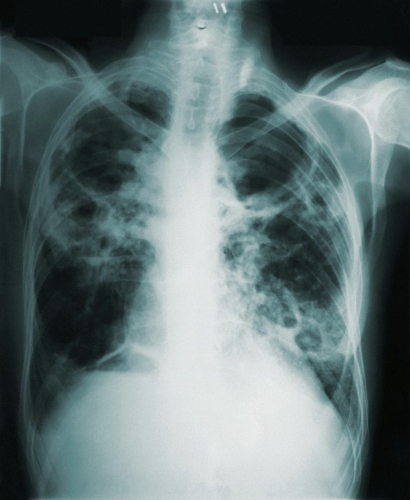

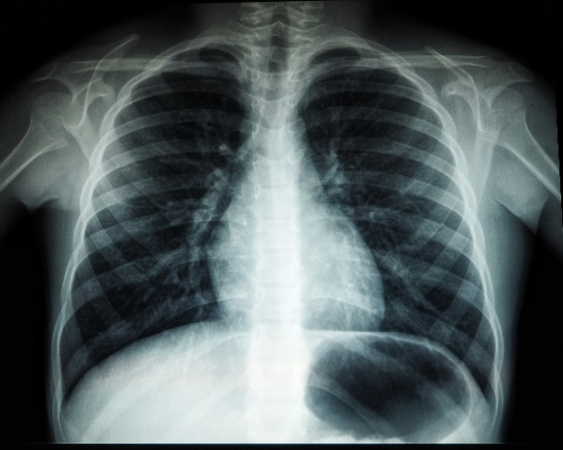
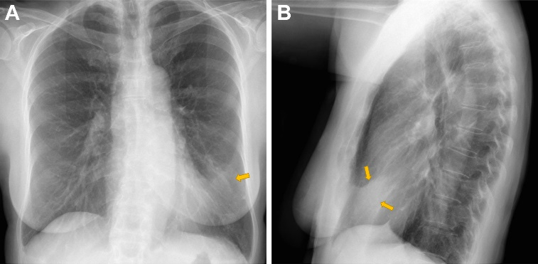
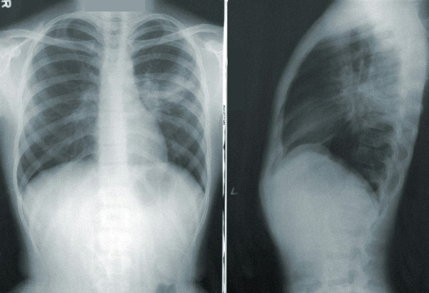
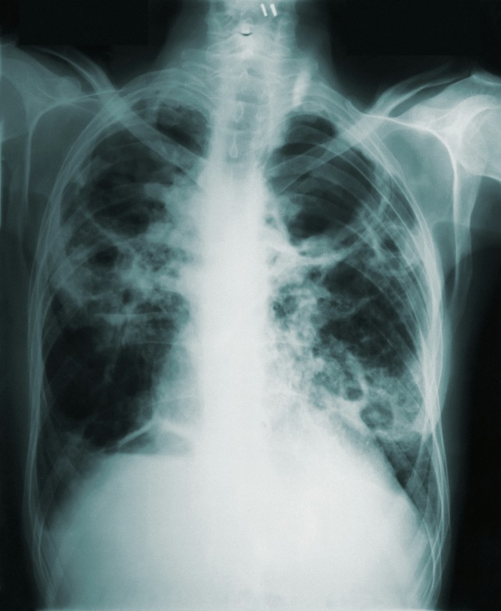

Dataset
80% for training the model
20% for checking the accuracy of the model
New CXR
Diagnosis
Lingular Pneumonia
Photo by Negative Space: https://www.pexels.com/photo/pink-white-black-purple-blue-textile-web-scripts-97077/
Photo by Tima Miroshnichenko: https://www.pexels.com/photo/photo-of-woman-writing-on-a-desk-5407206/

Slide 7
Foundational Libraries
Library | Usage
os | Provides a host of functions allowing interaction with the operating system
itertools | Provides various functions for creating and manipulating iterators
pathlib | Provides an object-oriented interface for working with file paths
cv2 | Uses include image loading, display, manipulation and filtering
numpy | Performs a wide variety of mathematical operations on arrays
Pandas | Used for working with data sets
Tensorflow | Creates dataflow graphs that describes how data moves through a graph
import os
import shutil
import itertools
import pathlib
from PIL import Image
import cv2 # 4.6.0 conda install -c conda-forge opencv
import matplotlib.pyplot as plt
import numpy as np
import pandas as pd
import seaborn as sns
sns.set_style('whitegrid')
import plotly.express as px
from sklearn.model_selection import train_test_split
from sklearn.metrics import confusion_matrix, classification_report
import tensorflow as tf
from tensorflow import keras
from tensorflow.keras.models import Sequential
from tensorflow.keras.layers import Conv2D , MaxPooling2D , Flatten , Activation , Dense , Dropout , BatchNormalization
from tensorflow.keras.preprocessing.image import ImageDataGenerator
from tensorflow.keras.optimizers import Adam, Adamax
from tensorflow.keras import regularizers

Slide 8
Model – Layer – Fine tuning parameters
img_size = (224, 224)
img_shape = (img_size[0] , img_size[1] , 3)
num_class = len(classes)
base_model = tf.keras.applications.efficientnet.EfficientNetB3(include_top = False , weights = 'imagenet',input_shape = img_shape, pooling= 'max’)
model = Sequential([
base_model,
BatchNormalization(axis= -1 , momentum= 0.99 , epsilon= 0.001),
Dense(256, kernel_regularizer = regularizers.l2(l= 0.016) , activity_regularizer = regularizers.l1(0.006),bias_regularizer= regularizers.l1(0.006) , activation = 'relu’),
Dropout(rate= 0.4 , seed = 75),
Dense(num_class , activation = 'softmax’)
])
model.compile(Adamax(learning_rate = 0.0001) , loss = 'categorical_crossentropy', metrics = ['accuracy’])
model.summary()

Slide 9
Training
Epochs = 10
history = model.fit(x= train_gen , epochs = Epochs, verbose = 1, validation_data = valid_gen,validation_steps = None , shuffle = False)
model = keras.saving.load_model('model.keras’)
preds = model.predict_generator(test_gen)
y_pred = np.argmax(preds , axis = 1)

Slide 10
Testing
image = cv2.imread('6.jpeg')
# img_size = (224 ,224)
# batch_size = 16
# img_shape= (img_size[0], img_size[1], 3)
image = cv2.resize(image,(224,224))
image = np.reshape(image,(1,224,224,3))
# image
x = model.predict(image)
print(x)
class_x = np.argmax(x,axis=1)
if class_x[0] == 0:
print('The person has no pneumonia.')
else:
print('The person has pneumonia.')

Slide 11
Productization & Go To Market
Build an app that can pick up the CXRs directly from Diagnostic Center Applications and tag CXR with AI Diagnosis before sending over to the Doctor. GTM: Partner with Diagnostic Centers
Build an app that be used by doctors and radiologists to upload CXR and get diagnosis insights. GTM: Partner with Hospitals and Doctors
Growth Opportunities
Expand the product to support CXR diagnosis for heart failure or pneumothorax, lung cancer, tuberculosis (TB) or interstitial lung diseases
Extend scope beyond CXR to all medical imaging such as CT Scan, MRI, Ultrasound etc.
Photo by Negative Space: https://www.pexels.com/photo/pink-white-black-purple-blue-textile-web-scripts-97077/

Slide 12


Thank You

